Slide 1

PRACTICAL
OBJECT-ORIENTED
DESIGN WITH UML
2e
Chapter 8:
Class and Object Diagrams
Class and Object Diagrams

Slide 2
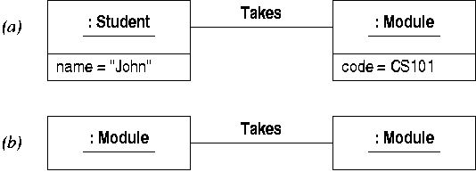
Static Models
Static models describe a system’s data
Object diagrams show a ‘snapshot’ of the data at a given moment
They can show both valid and invalid states:

Slide 3
Class diagrams
Class diagrams specify a system’s data structures, including:
  what objects can exist
  what data they encapsulate
  how they can be related
Valid object diagrams are ‘instances’ of a class diagram
  eg the class diagram would specify that only students can take modules

Slide 4
UML Data Types
UML defines familiar primitive data types
  data values are instances of data types
  unlike objects, values have no identity
Data types are represented as classes:
The values of these types are left implicit

Slide 5
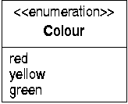
Enumerations
New enumerations can be defined
  values are enumeration literals
  specified in lower section of icon
Programming language types can also be used in UML models

Slide 6
Multiplicity
Multiplicities specify how often an entity can occur in some context
  a general notion used throughout UML
Represented by ranges
  a range has lower and upper bounds, eg 0..9
  * represents an unbounded multiplicity, eg 1..*
  0..* (‘zero or more’) is often abbreviated as *
  0..1 represents an optional entity
  1..1 is abbreviated to simply 1

Slide 7
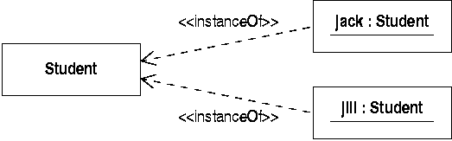
Classes
A class describes a set of similar objects
  eg that share data and operations
The objects are the instances of the class

Slide 8

Class multiplicity
Class multiplicity specifies the number of instances a class can have
The default is ‘0..*’, ie there is no limit placed on the number of instances
Sometimes it is useful to specify a singleton class that can only have one instance

Slide 9
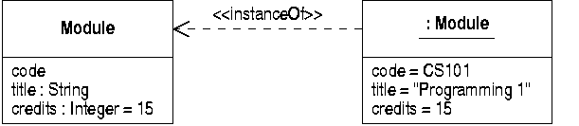
Attributes
Attributes describe data fields
  in a class, attributes can have a type
  which defines the values that an object can hold

Slide 10
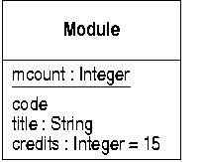
Attribute scope
By default attributes have instance scope
  each instance can have a different value
An attribute with class scope has one value
  shared by all instances of the class (‘static’)
  attributes with class scope are underlined

Slide 11
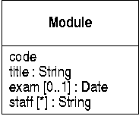
Attribute Multiplicity
Attribute multiplicity defines how many values an object stores for a attribute
  default is ‘exactly 1’
  ‘optional’ multiplicity shows possible null values
  arrays modelled by ‘many’ multiplicity

Slide 12
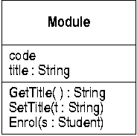
Operations
Operations define behaviour provided by every instance of the class
  defined in optional lower section of class icon
  parameters and return types optional

Slide 13
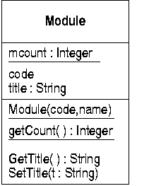
Operation Scope
Operations can have instance or class scope
  static functions and constructors shown with class scope

Slide 14
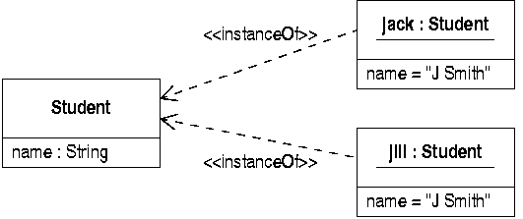
Object Identity
Object identities are implicit
  not the same as an attribute
  objects can share all attribute values and still be distinct

Slide 15
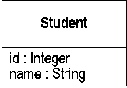
Object Identifiers
Many classes will have attributes with unique values
  corresponding to real-world identifiers
  UML notation does not specify uniqueness

Slide 16
Visibility of Class Features
Attributes and operations can have a visibility
  parallel to Java/C++ access levels
UML defines four levels of visibility:
  public (+): visible to all objects
  package (~): visible to objects in same package
  protected (#): visible to instances of subclasses
  private (-): visible only in same object

Slide 17

Associations
Relationships between objects are modelled by links
These relationships are specified by an association between the relevant classes
  eg a Person can work for a Company

Slide 18

Links
Links can be shown connecting instances of related classes

Slide 19

Association Ends
Association ends can annotated with
  a label, describing the role played the class at that end in the relationship
  multiplicity, showing how many instances an object at the other end can be linked to

Slide 20
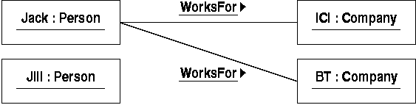
Association Multiplicity
This association states that:
  a Person works for exactly 1 Company
  a Company has zero or more Persons working for it
This rules out situations like this:

Slide 21

Navigability
By default, associations can be navigated in either direction
  ie given an object at one end you can access a linked object at the other, and vice versa
Navigability can be restricted
  sometimes we only need access in one direction

Slide 22
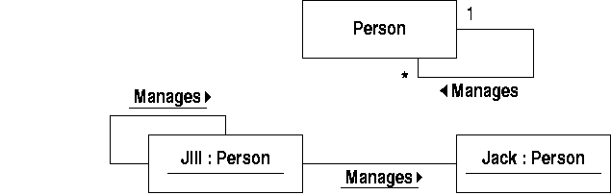
Types of Association
Most associations are binary
Some associations relate objects of the same class
  these can be shown as self-associations

Slide 23

Labelling Associations
All association labels are optional
Multiplicity information is usually shown
Labels are used where necessary
Some labelling is required to distinguish associations between the same classes

Slide 24
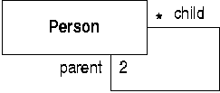
Use of Role Names
Role names are often used to distinguish the ends of a self-association

Slide 25
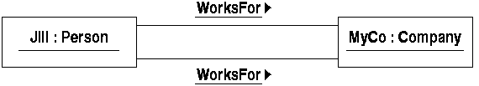
Semantics of Associations
There can only be one instance of an association linking a given pair of objects
  for example, a person might have two contracts with a given company
  the model below is wrong, however

Slide 26
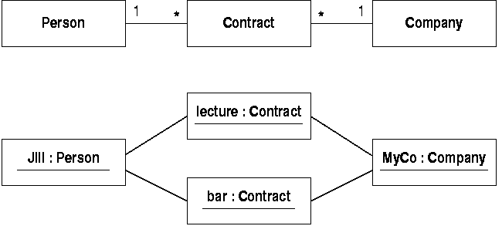
Reifying Associations
Introduce a ‘linking’ class to deal with repeated links

Slide 27
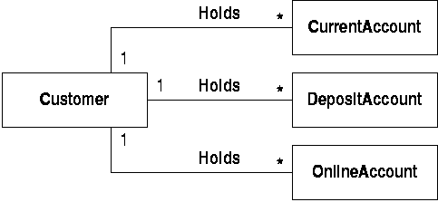
Shared Properties
Often groups of classes share properties
  they have the same attributes and operations
  they share associations with other classes

Slide 28
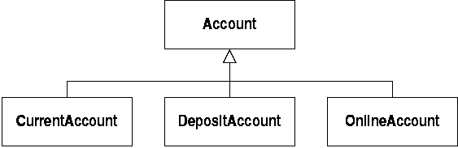
Generalization
Models this relationship between classes
  define a superclass representing the general shared properties of accounts
  other account types are specialized subclasses

Slide 29
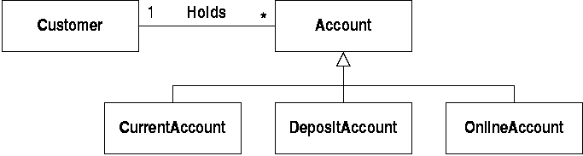
The Meaning of Generalization
The superclass defines the properties shared by all the specialized classes
  eg customers can hold accounts of any sort

Slide 30
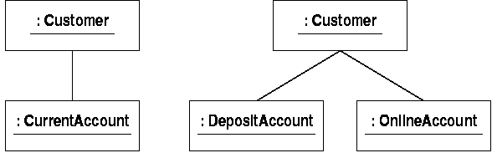
Substitutability
This model connects customers to accounts
  but an instance of any subclass can be substituted for an account object
  these links demonstrate polymorphism

Slide 31
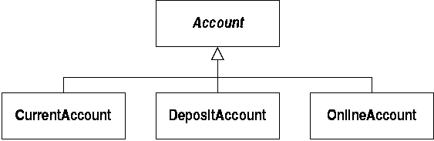
Abstract Classes
Superclasses are often defined solely to group together shared features
  it may not make sense to have an instance of a superclass
  in this case, define the class as abstract

Slide 32
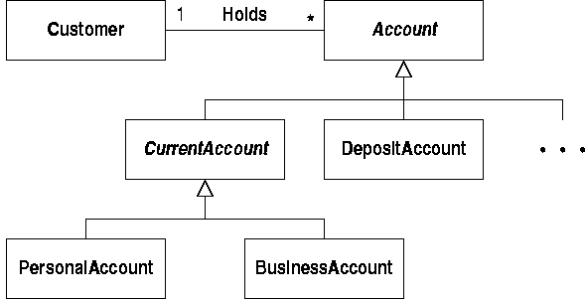
Generalization Hierarchies
Generalization can be carried out at more than one level

Slide 33
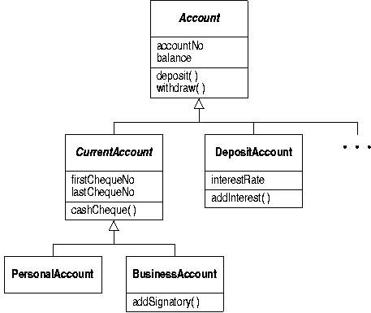
Inheritance
Inherited features also belong to subclasses

Slide 34
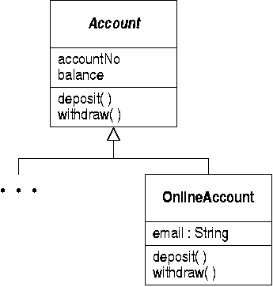
Modifying Subclasses
Subclasses can:
  add features to model special properties
  override operations to implement specialized behaviour

Slide 35
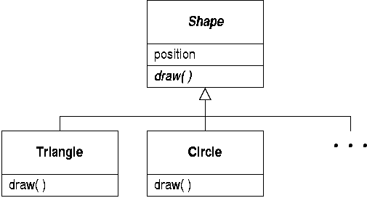
Abstract Operations
Some operations cannot be implemented in abstract classes
  define them as abstract and override them

Slide 36
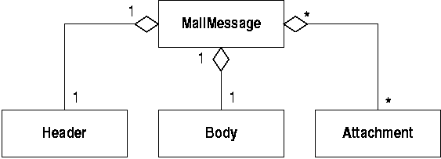
Aggregation
Informal ‘whole-part’ relationships can be modelled using aggregation
  a specialized form of an association
  can have standard annotations on ends

Slide 37
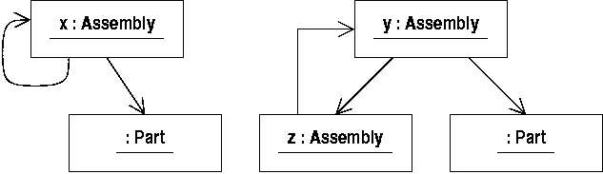
Cyclic Object Structures
Aggregation is useful for ruling out invalid cyclic object structures
  eg where an assembly contains itself, directly or indirectly

Slide 38
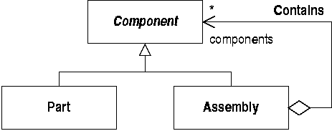
Properties of Aggregation
Aggregation rules this out because it is
  antisymmetric: an object can’t link to itself
  transitive: if a links to b and b to c, a links to c

Slide 39

Meaning of Aggregation
Sometimes there is a conflict
Eg people cannot be their own ancestors
  this can be specified using aggregation
  but a person’s ancestors are not parts of them!

Slide 40
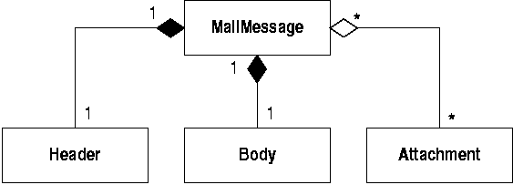
Composition
Composition is a strong form of aggregation
  parts can only belong to one composite at a time
  parts are destroyed when a composite is

Slide 41
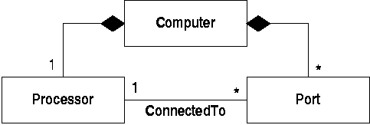
Component Relationships
Component parts can be related even if they don’t belong to the same composite
  sometimes this is not what is needed

Slide 42
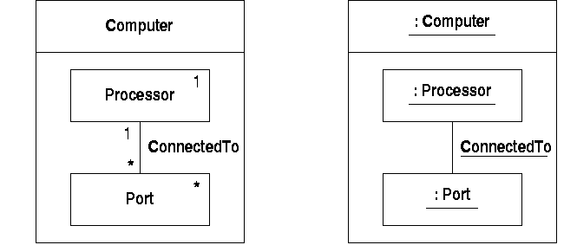
Associations and Composites
An alternative notation allows associations to be defined inside composites

Slide 43
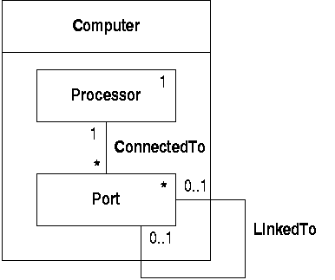
Composite Boundaries
Associations can cross the boundary to link objects in different composites

Slide 44

Properties of Links
Sometimes data belongs to a link
  a student takes a module and gets a mark for it
  the mark only makes sense if we know the student and the module
  so it’s not simply an attribute of either class

Slide 45
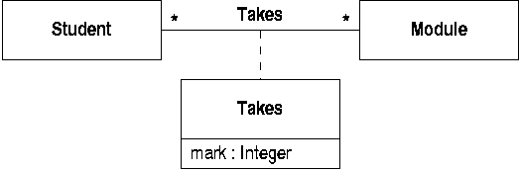
Association Classes
Association classes share the properties of associations and classes
  they can define links between objects
  they allow attribute values to be stored

Slide 46

Reification
Students’ marks could alternatively be stored in an intermediate class:
  this has the property of allowing students to take a module more than once

Slide 47
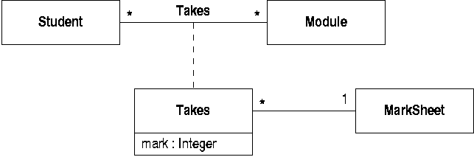
Association Class Properties
Association classes are classes and so can participate in associations

Slide 48
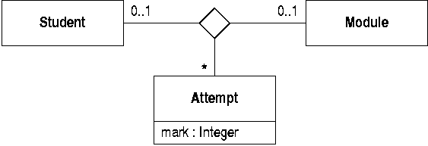
N-ary Associations
Associations can connect more than two classes
  A 3-way association could be used to store marks

Slide 49
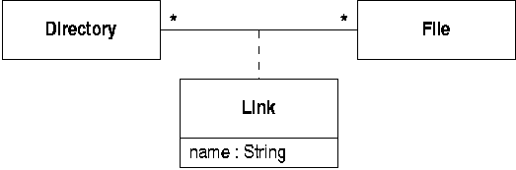
Modelling Unix Files
Unix files can appear in many directories, under different names
This could be modelled with an association class

Slide 50

Qualified Associations
There are two problems with this:
  it doesn’t allow the same file to appear twice in a directory (under different names)
  it doesn’t specify that names can only be used once in each directory
Using a qualified association solves these

Slide 51
Qualifiers
The ‘name’ attribute is known as a qualifier
It acts like a ‘key’: within a directory, each name maps to zero or one file
  this guarantees that names are unique within directories
Files are linked to names within directories, so multiple occurrences within a directory are possible

Slide 52
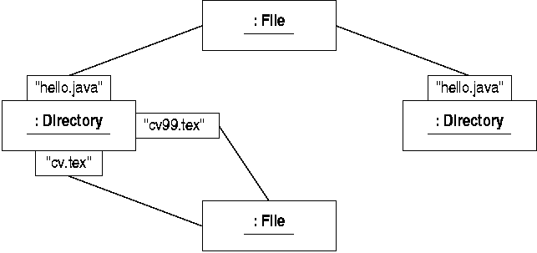
Qualified links
Here is a typical structure of objects linked with qualifiers

Slide 53
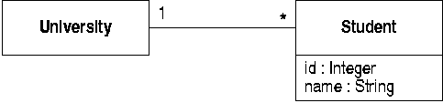

Qualifiers and Identifiers
Use a qualifier to model an identifying attribute that is unique within some context

Slide 54

Interfaces
An interface in UML is a named set of operations
  shown as a stereotyped class
Generalization can be defined between interfaces

Slide 55


Realizing an Interface
A class realizes an interface if it provides implementations of all the operations
UML provides two equivalent ways of showing this relationship

Slide 56
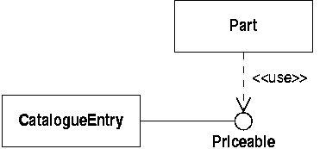
Interface Dependency
A class can be dependent on an interface
  this means that it only makes use of the operations defined in that interface

Slide 57

Interface Specifiers
This dependency can also be shown using an interface specifier on an association

Slide 58
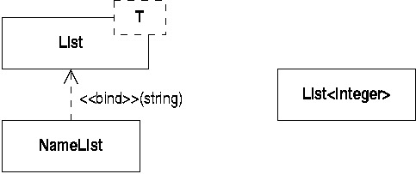
Templates
Parameterized model elements can be shown as templates
  these are commonly used to show generic or template classes and operations (as in C++)

